Slide 1


WP2 Implementation Strategy/Workplan
Task 2.3 Design and specification of SDN interfaces (M06-M21) NXW, TIM, ICCS/NTUA, NBLF
Users, Applications, …
SDN Controller interfaces and device abstract information model:
North-bound interface based on a technology-indipendent REST API (e.g. intent-like) for a relevant set of transport network services and virtual network slicing service
Possible re-use and extention of result of ongonoing strandarization activities (e.g. Transport API in ONF)
South-bound interface based on a suitable well-knonw protocol (e.g. NETCONF or OpenFlow with optical extension) for configuration and control of optical devices.
Specific extension for the single devices
Optical devices (Transceivers, ROADMs) abstracted using YANG models and following the disaggregrated modelling paradigm
North-bound Interface (NBI)
South-bound Interface (SBI)
Device Agent
Device Agent
Device Agent

Slide 2
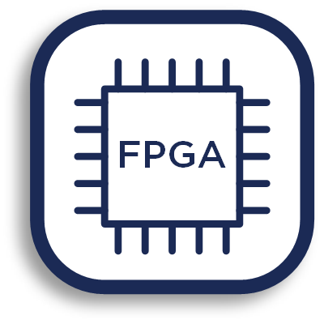

WP2 Implementation Strategy/Workplan
Task 2.3 Design and specification of SDN interfaces (M06-M21) NXW, TIM, ICCS/NTUA, NBLF
c3
SDN Controller SBI and device disaggregated model:
Single optical devices (e.g. ROADMs) are represented as a composition of multiple sub-components interacting together
Each sub-component can be represented by a proper YANG model in terms of data and functionalities (e.g. commands)
c1
c2
Models (YANG)
Composition of models as representation of device functionality
Impact on Controller SBI (i.e. Controller-Agent interface)
Standard configuration/control protocols (e.g. NETCONF) extension driven by models.
Model Driven Interface
SDN Controller
Model-driven
Controller-Agent Interface
SDN Agent(s)

Slide 3
WP[number] Implementation Strategy/Workplan
North-bound Interface (NBI)
Unified NB APIs (RESTCONF)
Core Functions:
Topology
Statistics
Flow Mngmt
QAMeleon Plugin
(SBI protocol specific)
South-bound Interface (SBI)
Towards Device Agents

